Slide 1
Procedural World Generation
马逸涵
2018.12.29

Slide 2
In this representation
Terrain FX - Houdini toolset
Cliff Tool - Houdini toolset
Biome Generation Tool - Houdini toolset
Landscape - Unreal Engine
Not in this representation
Rendering/Shading Tech
Engine Basic Algorithm
Digital Content

Slide 3
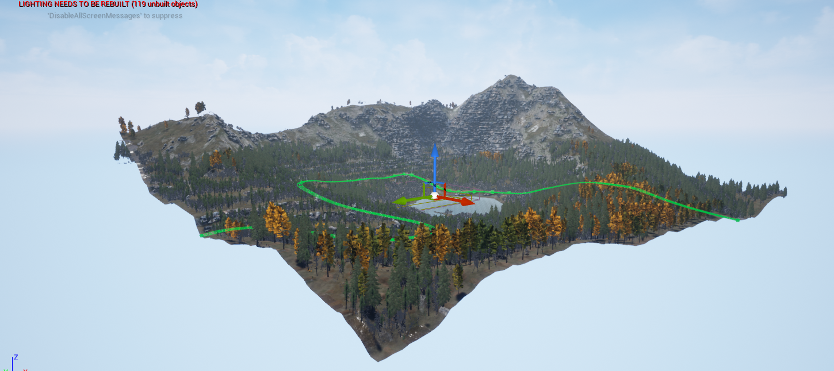
Area : 1km*1km
Entities : 78326
Sub Biome : 19
Grass Type : 10

Slide 4
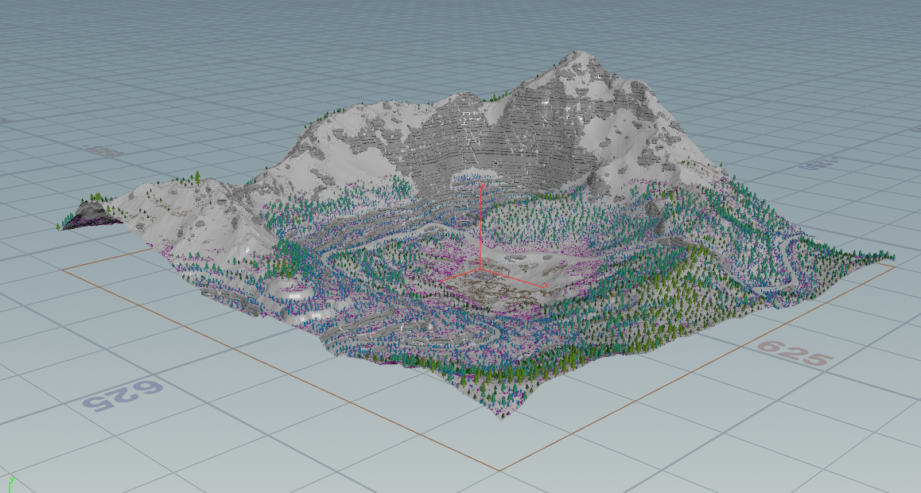
Area : 1km*1km
Entities : 78326
Sub Biome : 19
Grass Type : 10

Slide 5
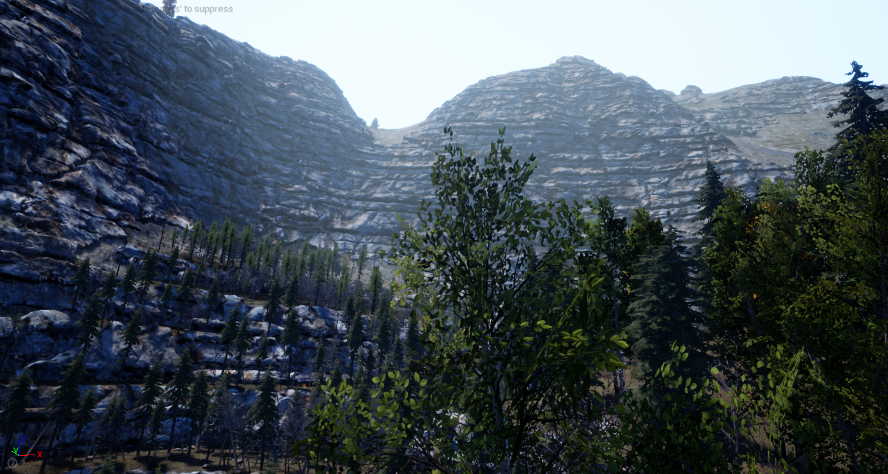
UNREAL 4.20
HOUDINI FX 17.0

Slide 6
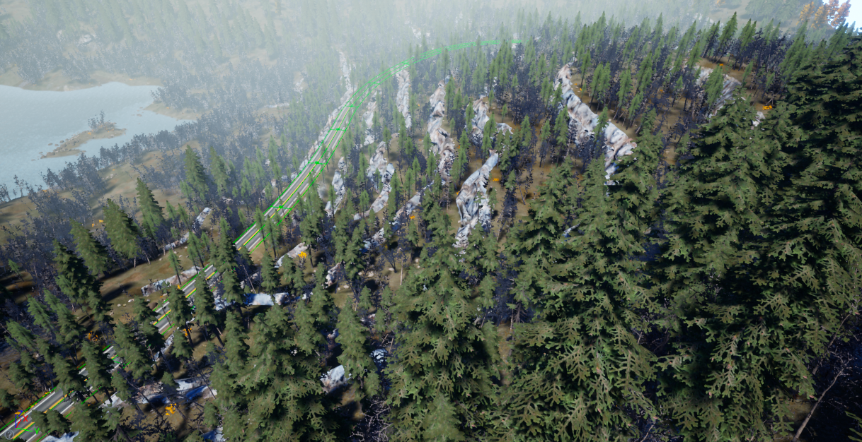
UNREAL 4.20
HOUDINI FX 17.0

Slide 7
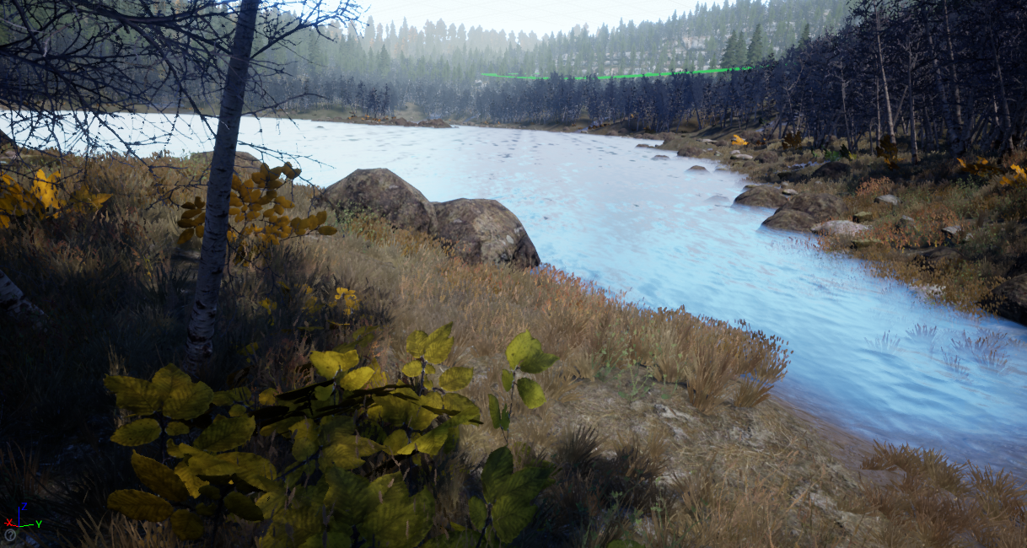
UNREAL 4.20
HOUDINI FX 17.0

Slide 8
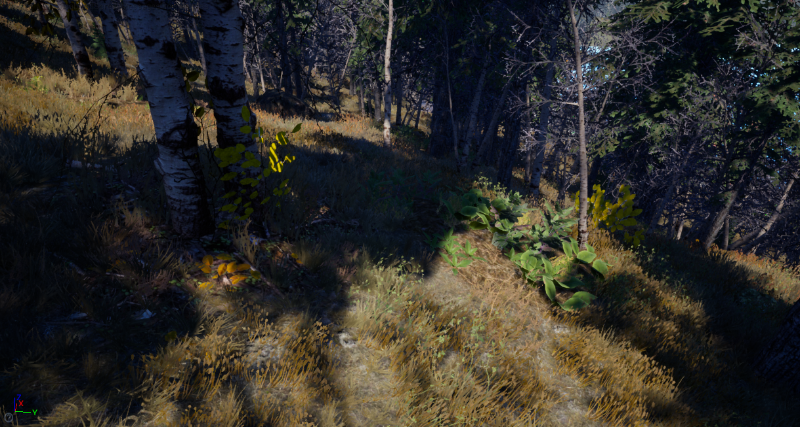
UNREAL 4.20
HOUDINI FX 17.0

Slide 9
Pipeline
HOUDINI ENGINE FOR UNREAL
HOUDINI
OUTPUT
UE4
INPUT
OUTPUT
Entity point cloud
Terrain texture layer
2D terrain data(RGB)
Geometry
INPUT
HeightField mask
Splines

Slide 10
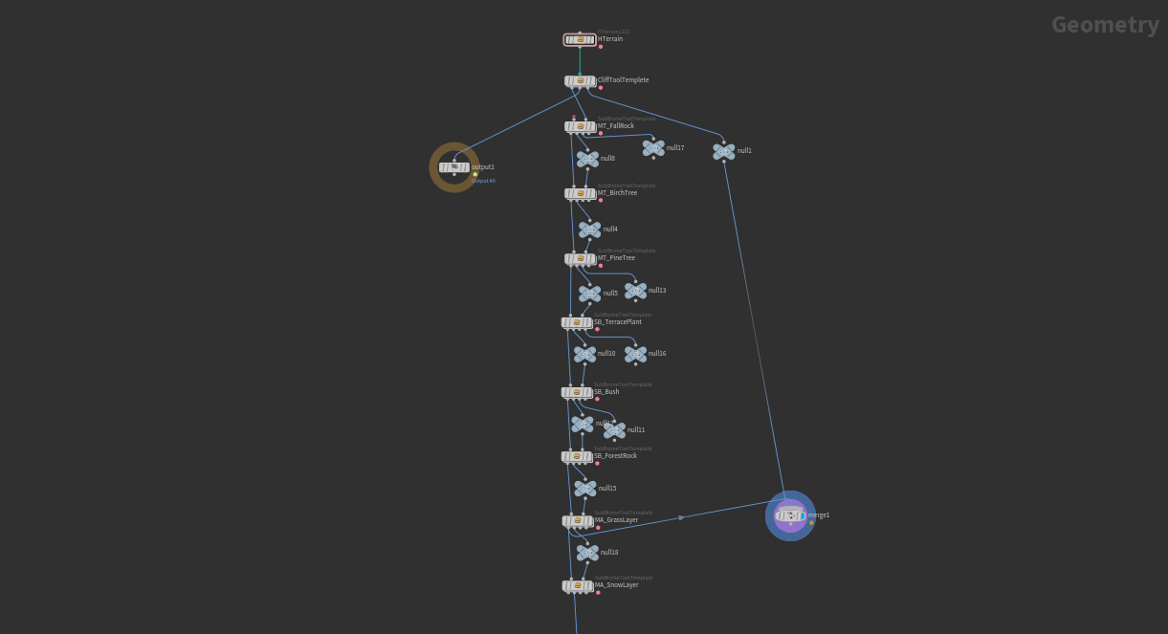
Terrain Subnet
Cliff Tool
Biome Tool

Slide 11
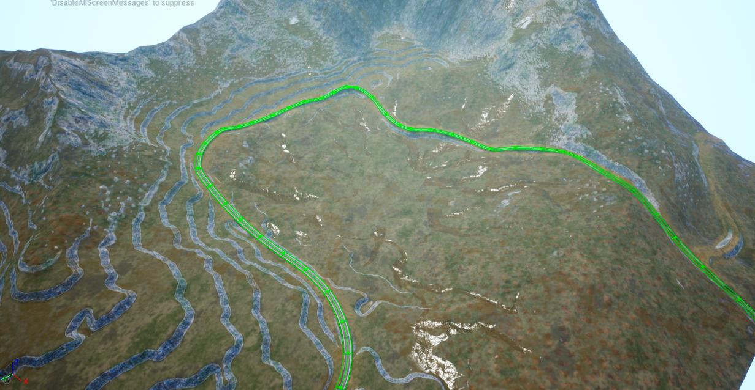
Houdini Terrain FX
Procedural terrain generation

Slide 12
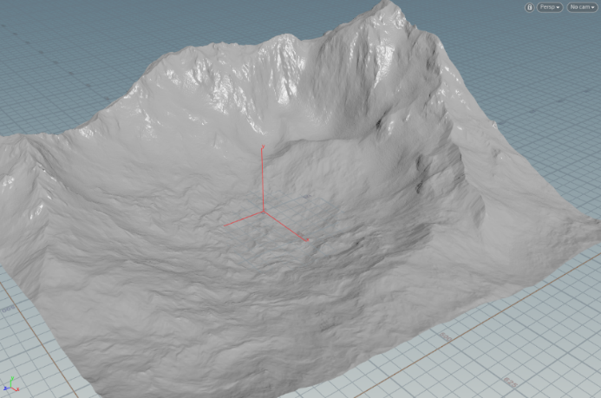
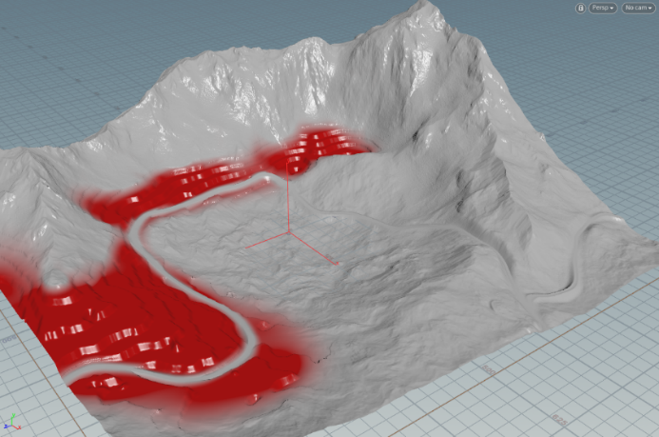
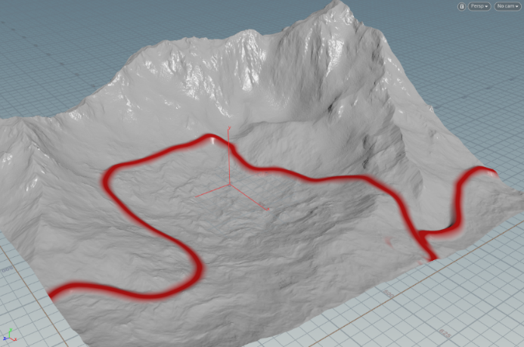
Terrain Tool-Houdini Terrain FX
Procedural terrain generation.
30+ dedicated nodes(blur/noise/terrace/erode/flow/slump).
Straightforward workflow, similar to image compositing but in 3D.
Masks limit operations to certain areas.
Viewport visualization of 2D height fields as 3D surfaces, and masks as surface tinting.
Very fast: hardware accelerated via OpenCL.

Slide 13
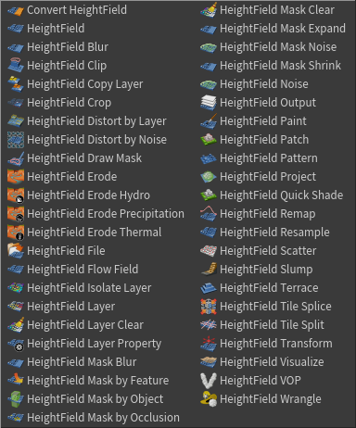
Terrain Tool-Houdini Terrain FX
HeightField Procedural Operator
Noise
Flow Field
Erode
Terrace
Slump
Mask Operator
Mask by feature : Slope / Direction /
Altitude / Occlusion / Curvature
Mask Expand / Blur / Box Blur / Shrink
Paint
Project

Slide 14
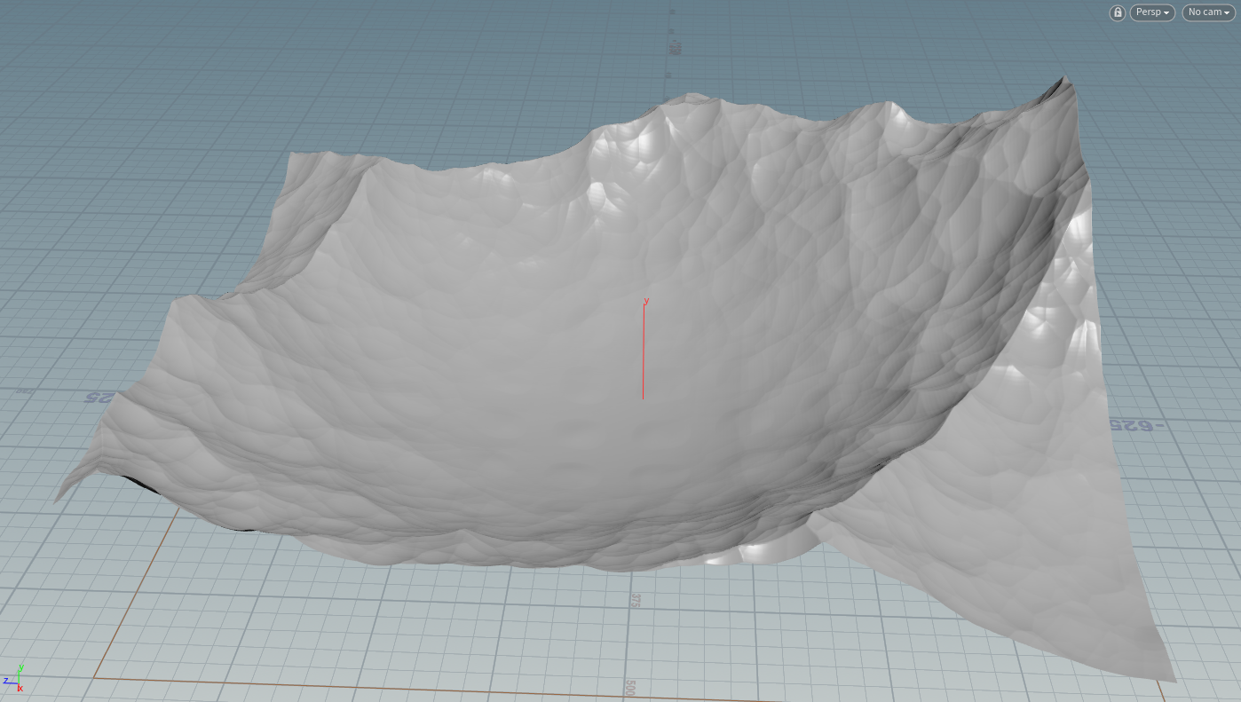
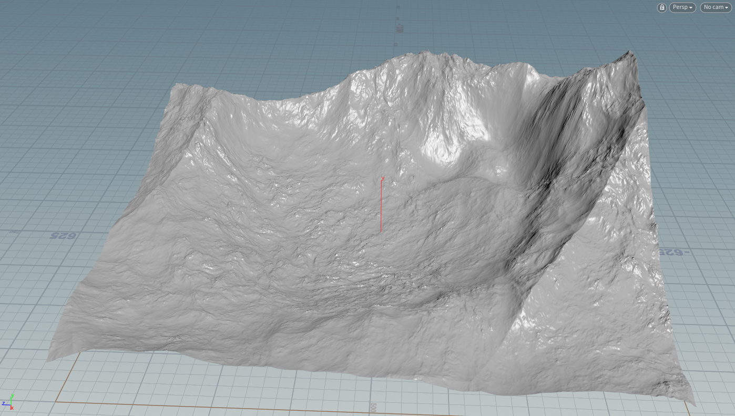
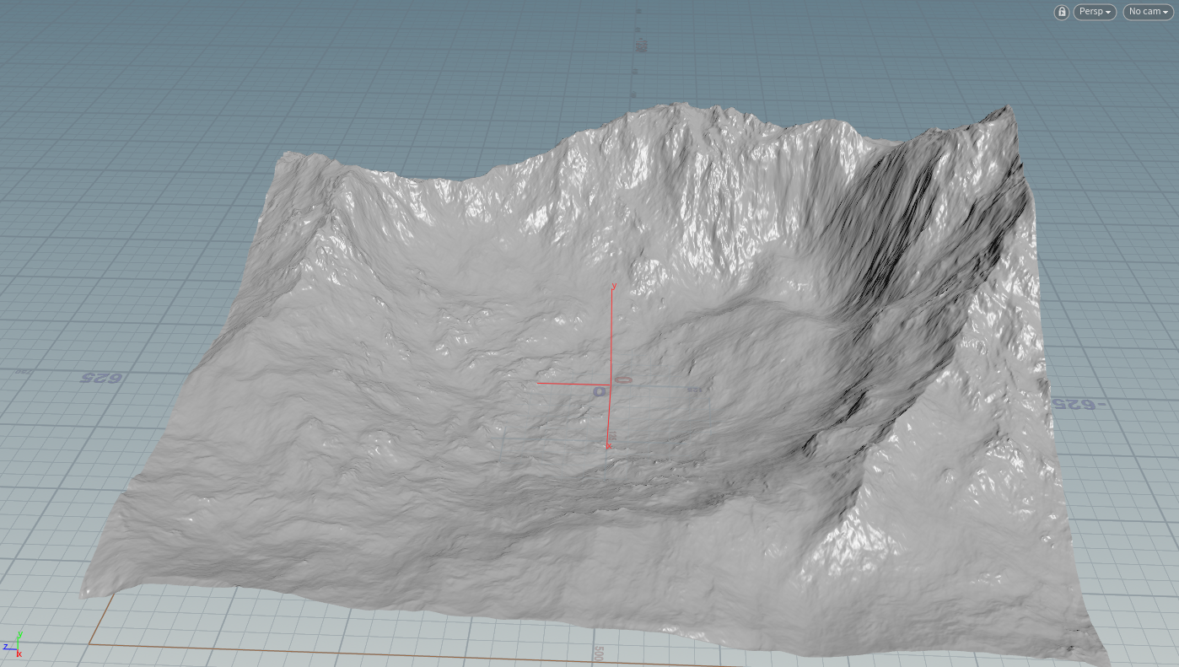
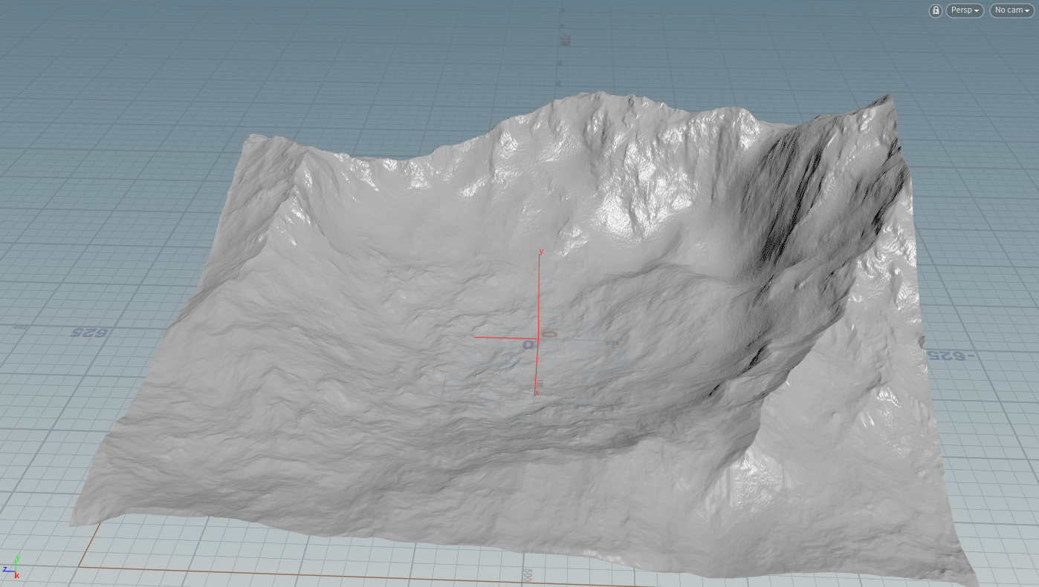
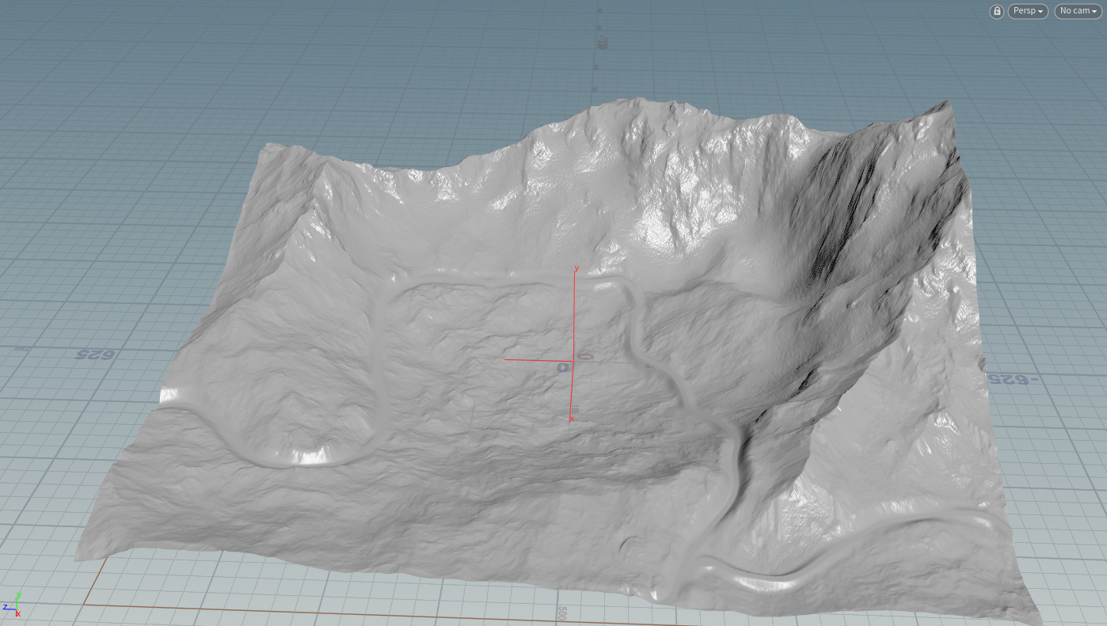
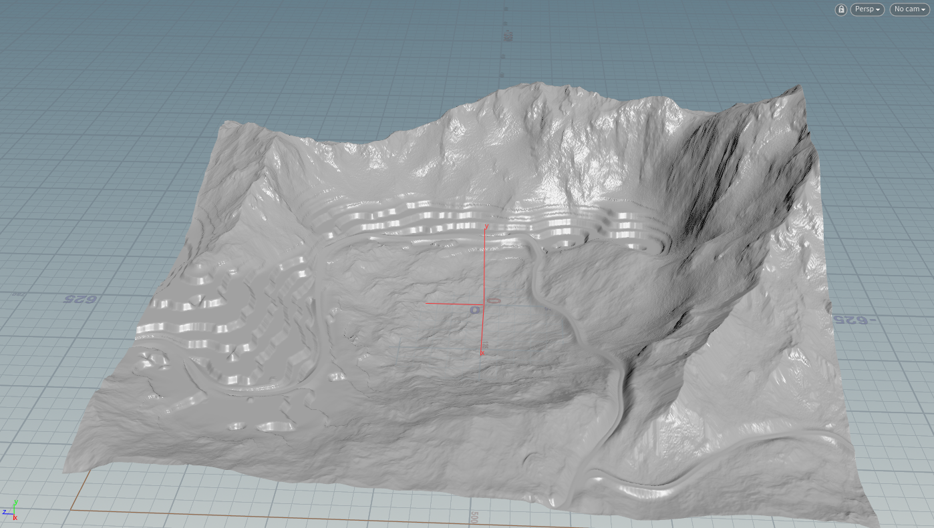

Slide 15
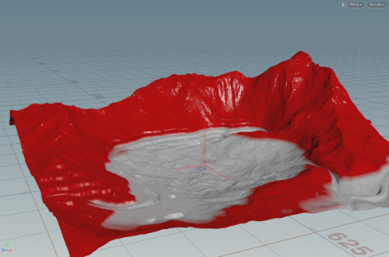
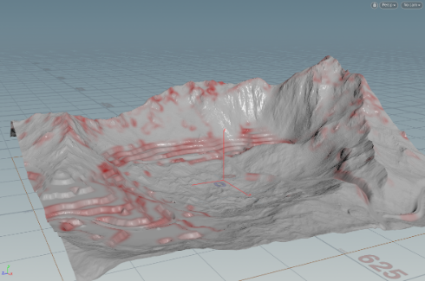
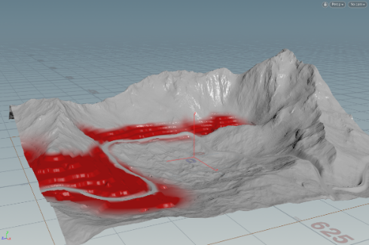
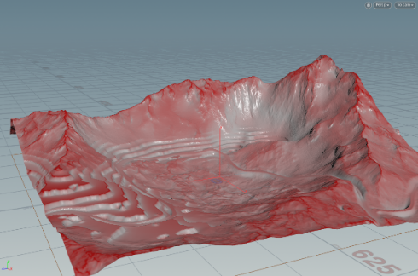
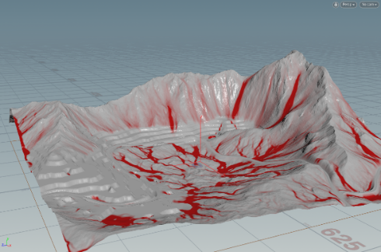
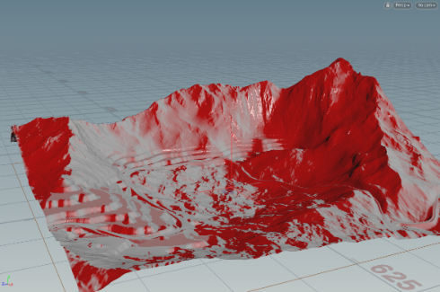
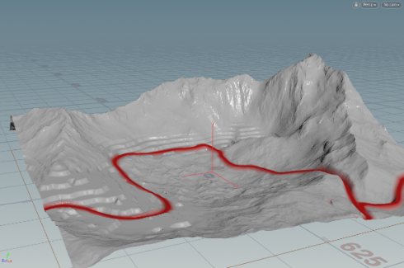
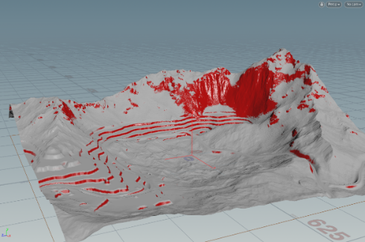
Terrain Tool-Houdini Terrain FX
Height Layer-> Landscape height map
Mask Layer-> Landscape Layer
Altitude Falling Rock Terrace Occlusion
Flow Direction Road Cliff

Slide 16
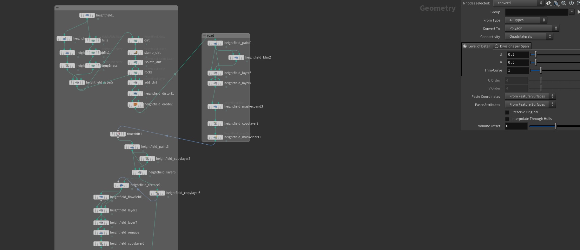
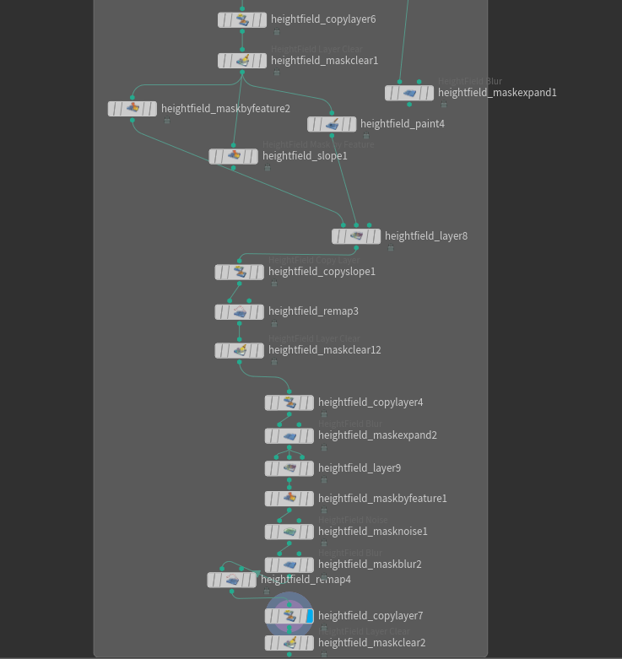

Slide 17
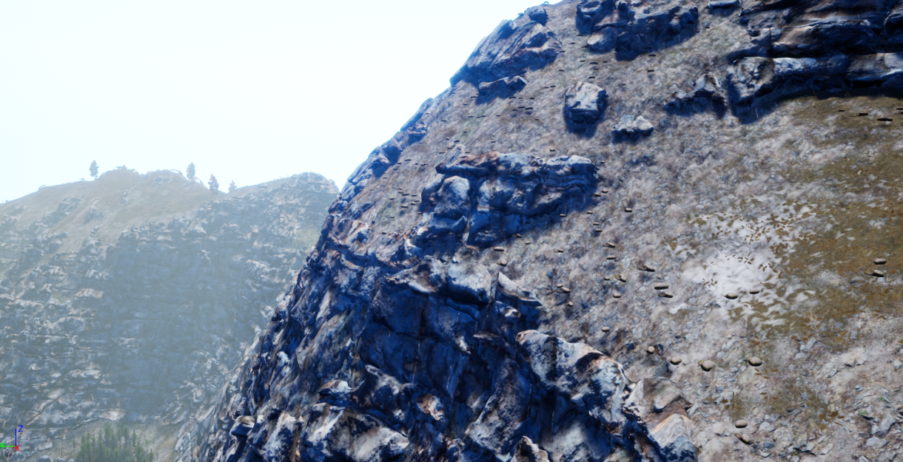
Cliff Tool
Extrude and remesh cliff

Slide 18
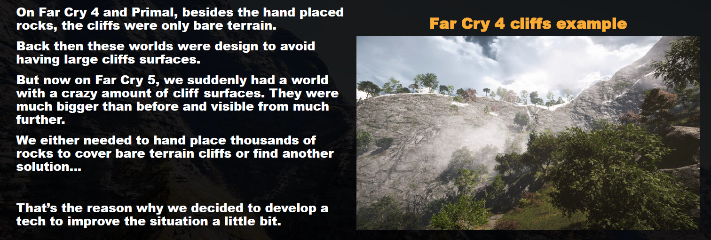
Cliff Toolset
Previous Tech
Hand place rock
Tri-planer mapping UV：Depending on the angle of our normal, we blend 3 projections of the world position aligned to each of the x, y, z axis.

Slide 19
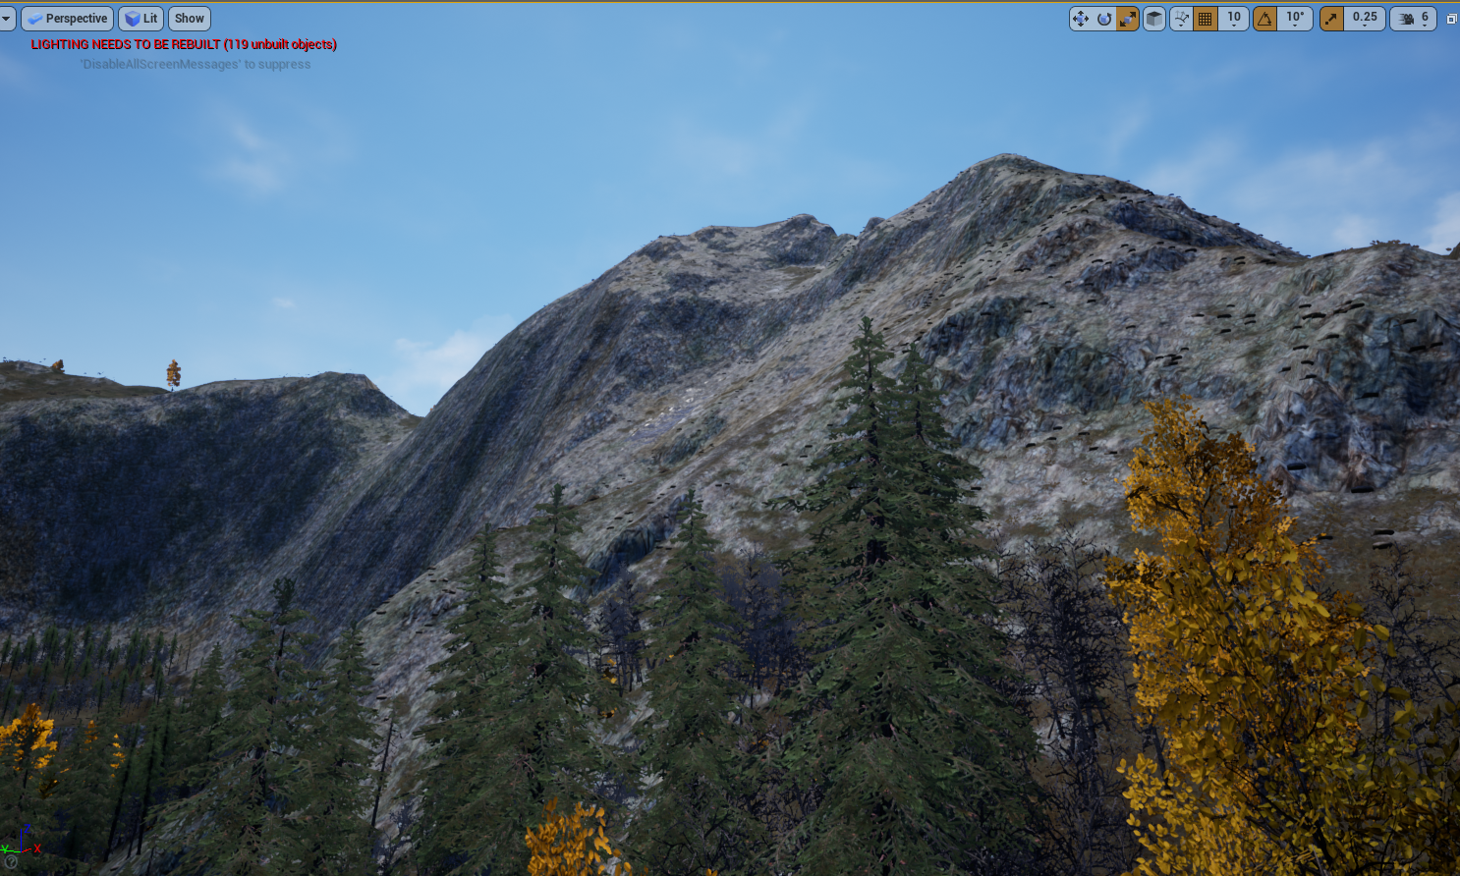
BEFORE

Slide 20
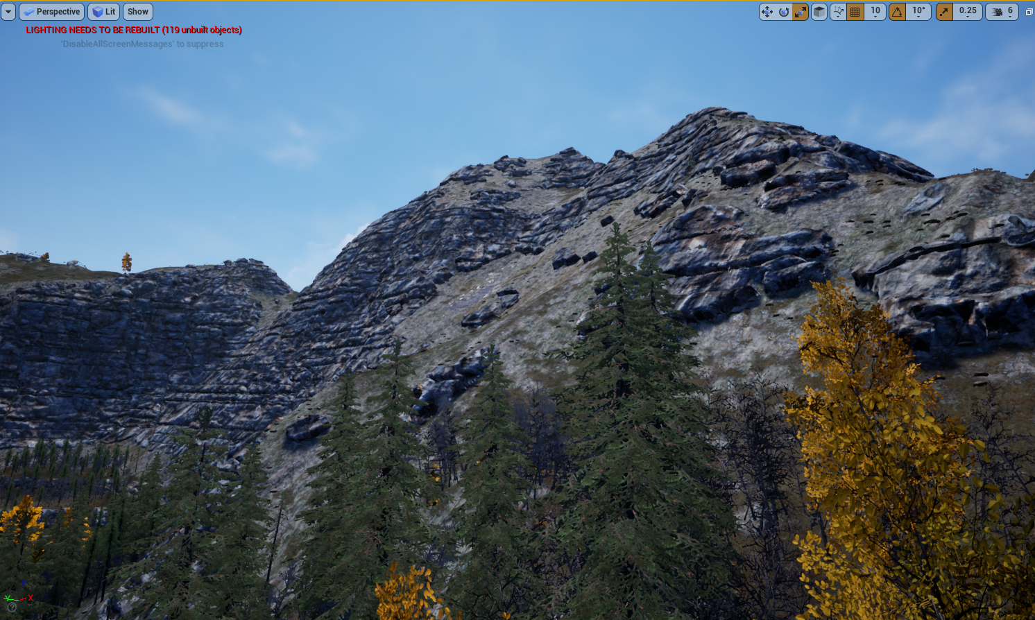
AFTER

Slide 21
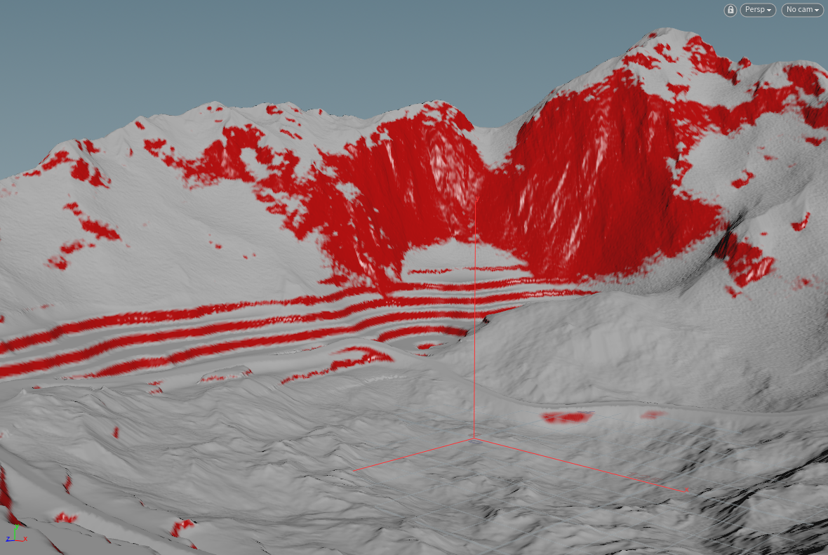
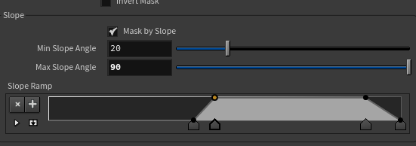
Cliff Tool
Use slope mask as input, convert to mesh and record point mask value(0~1)

Slide 22
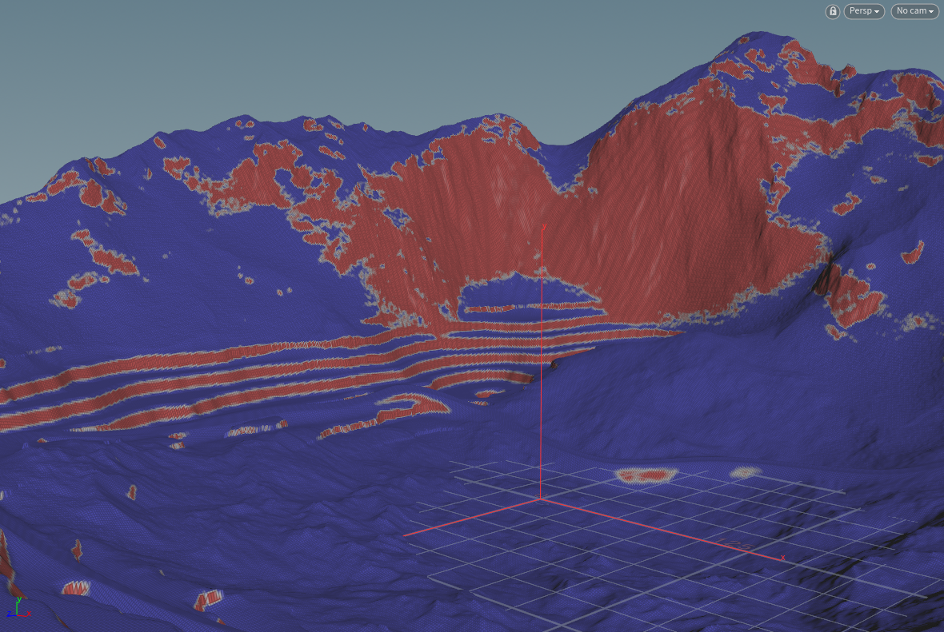
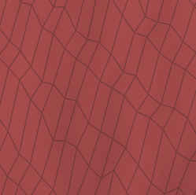

Cliff Tool
Remesh, convert stretch quads to uniform triangles

Slide 23
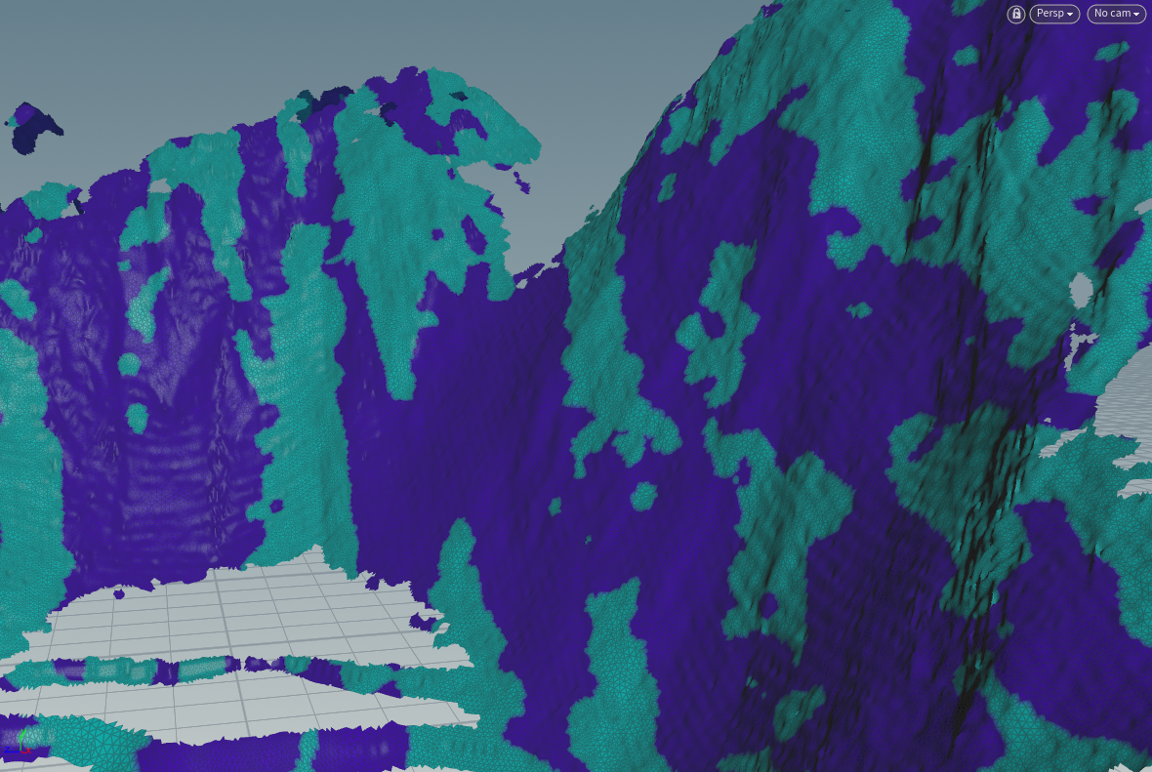
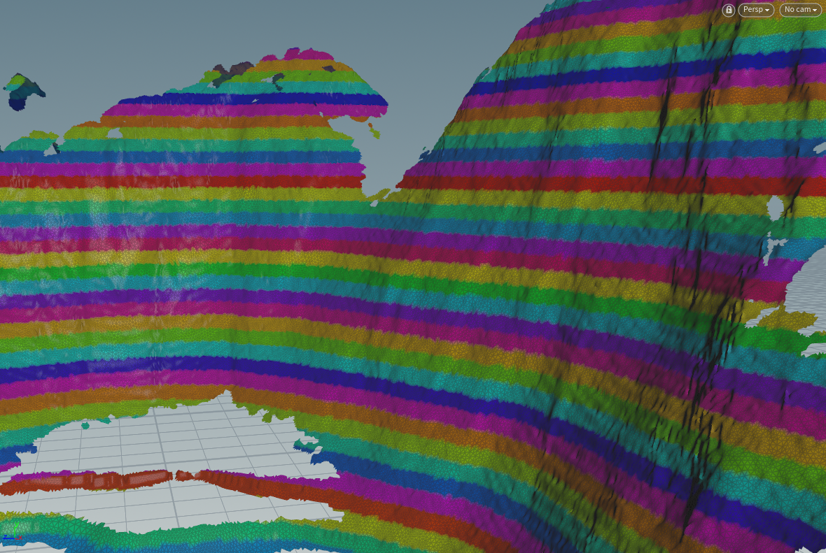
Cliff Tool
Calculate horizontal lines according P.y, use noise to split in two groups
X

Slide 24
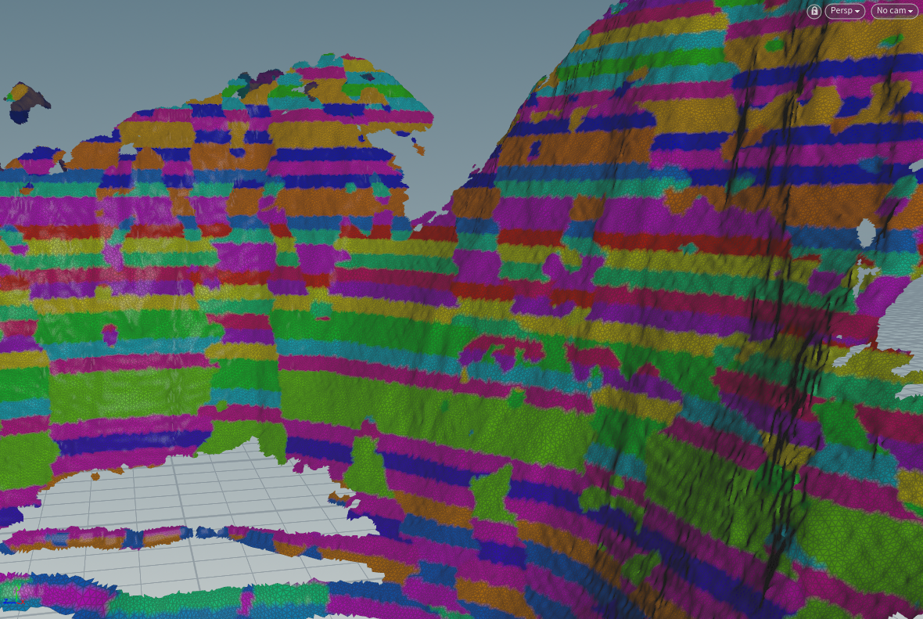
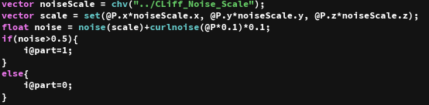
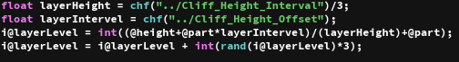
Cliff Tool
Offset one group’s strata, each strata has a random thickness and it assign a strata ID to each slice

Slide 25
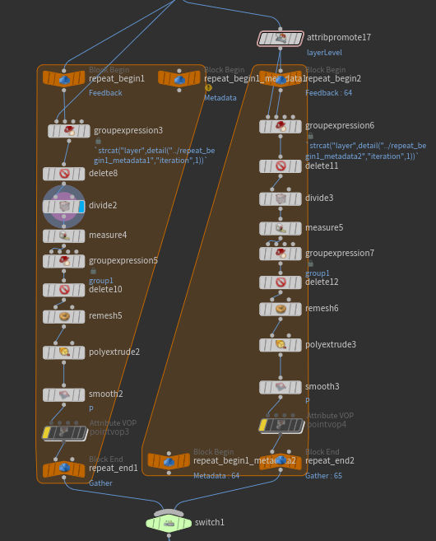
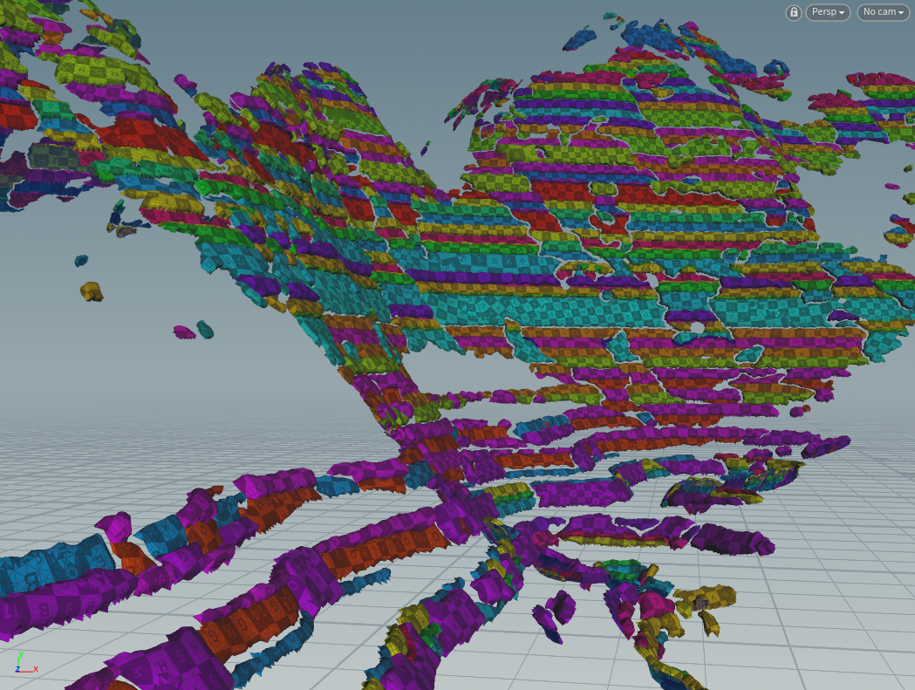
Cliff Tool
Break up and traversing each strata, delete useless strata according to area, poly extrude at random thickness and use SOP_autoUV(Game Development Toolset) .

Slide 26
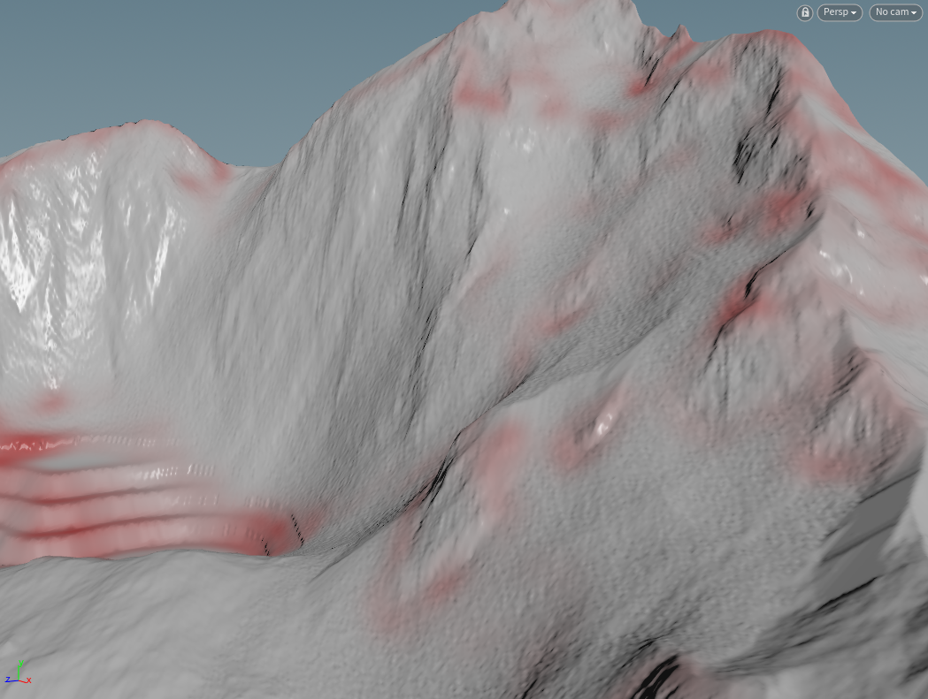
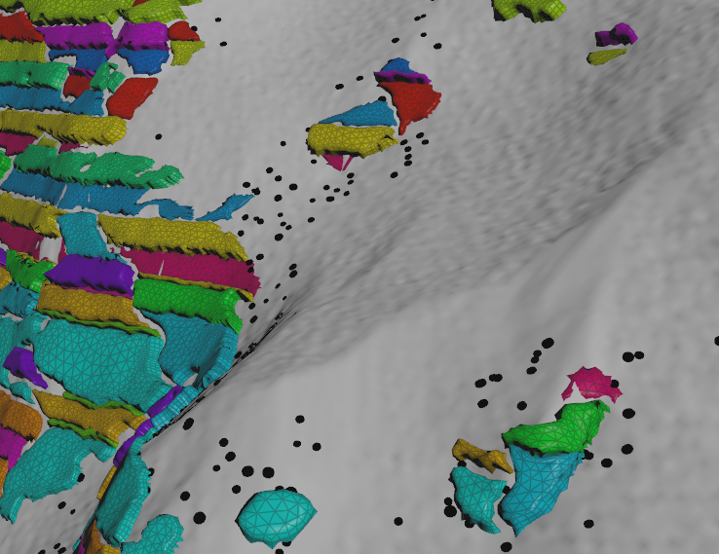
Cliff Tool
Calculate crumbled rock layer, scattered on the erosion surfaces

Slide 27
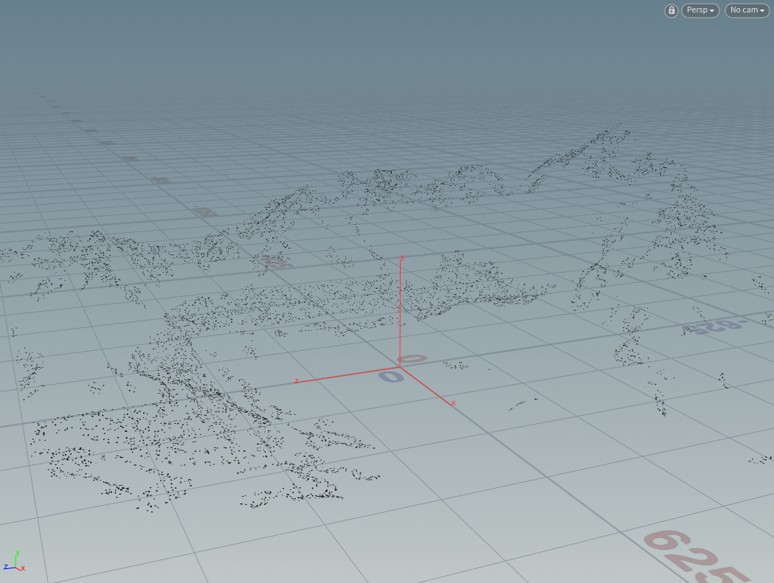
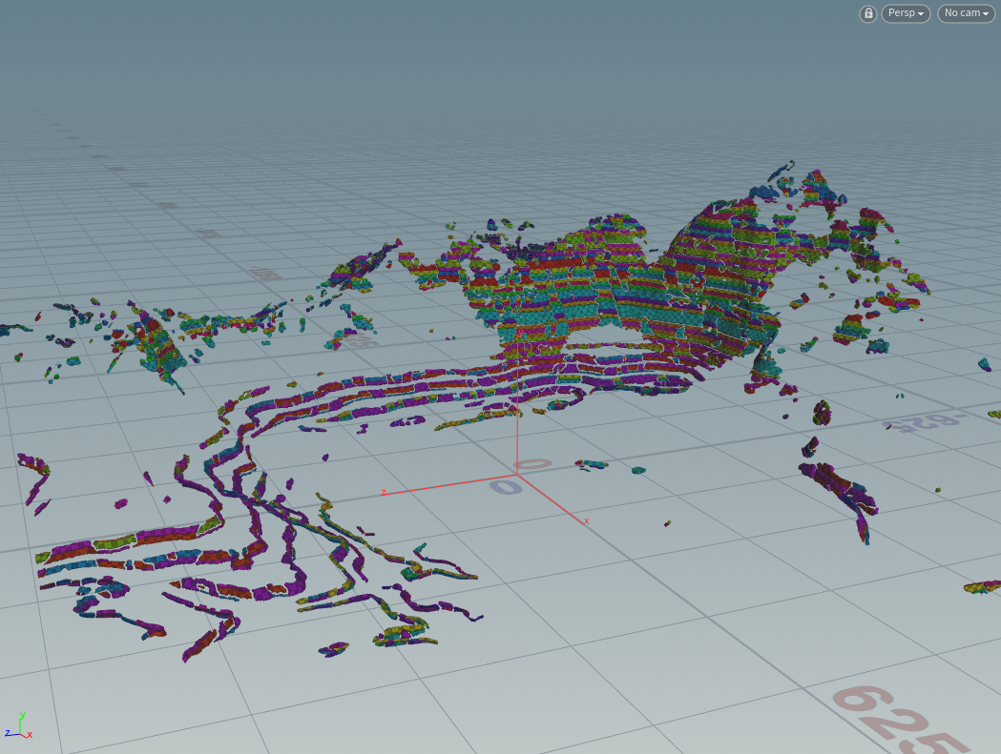
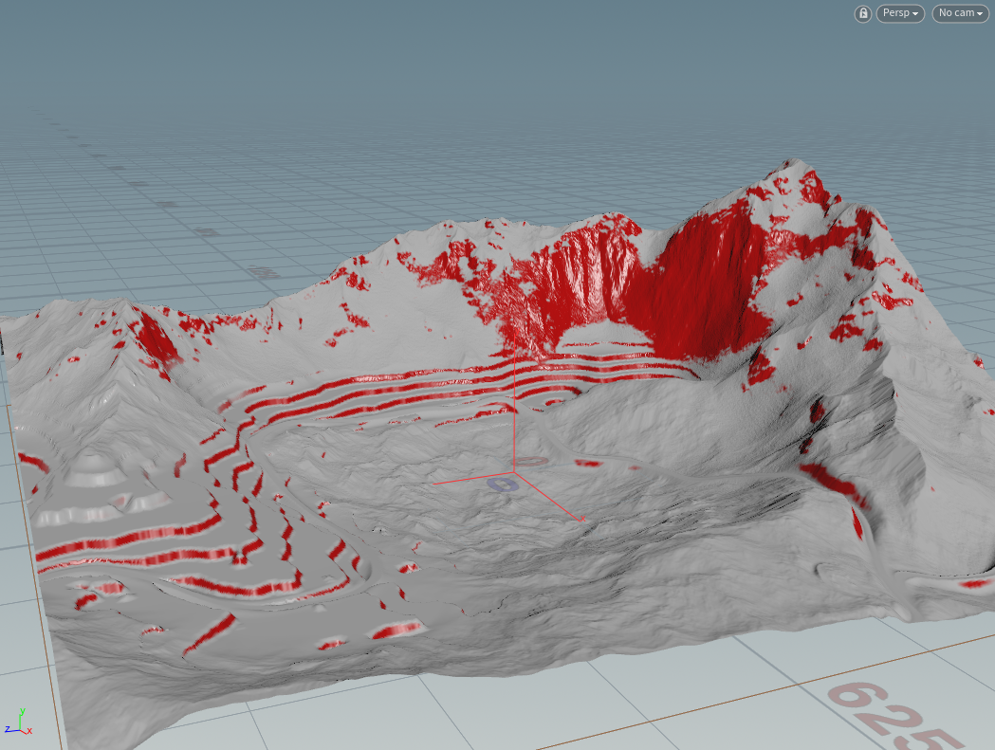
Cliff Tool
Export to UE4
Entities point cloud(rocks)
Geometry(with collision)
Cliff Mask

Slide 28
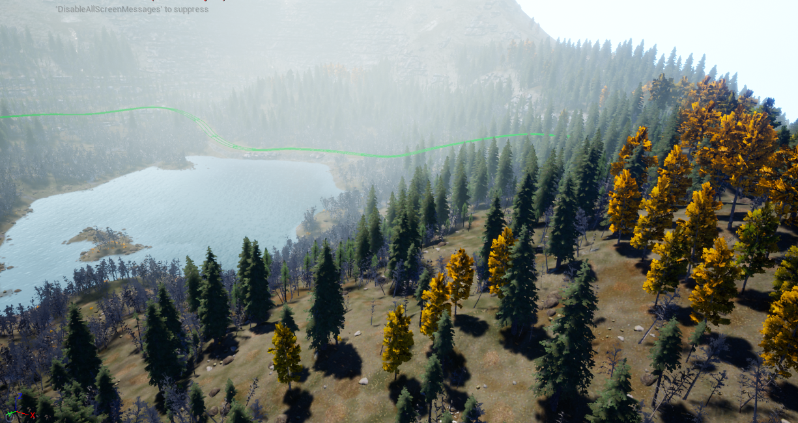
Biome Generation Tool
Auto create large scale result in scene

Slide 29
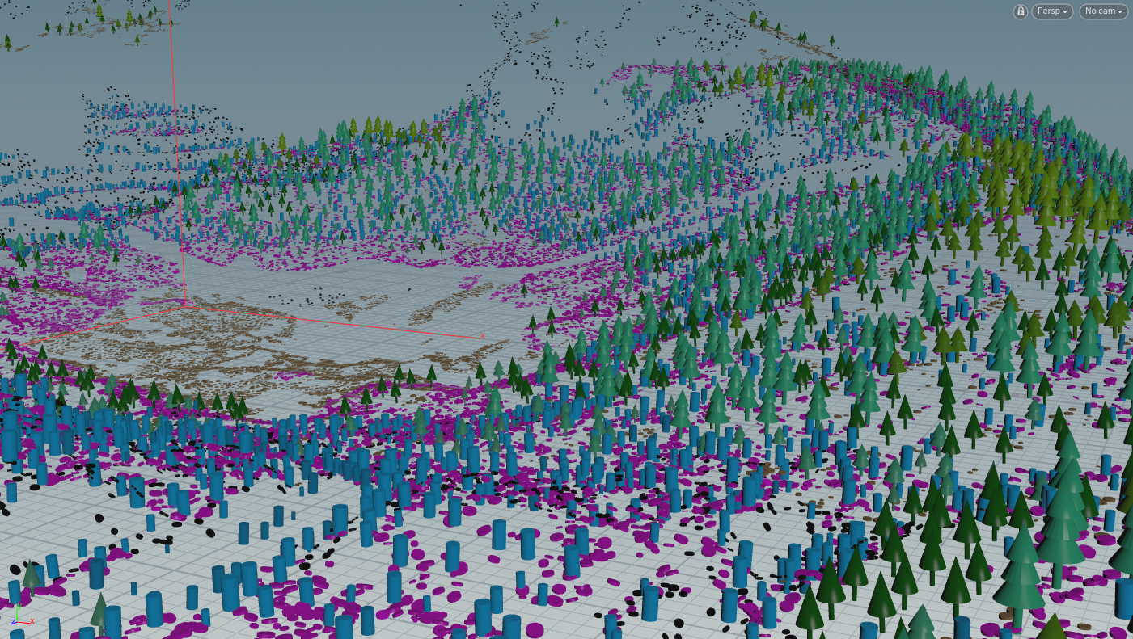
Biome Generation Tool
Auto create large scale result in scene

Slide 30

Biome Generation Tool

Slide 31

Biome Generation Tool

Slide 32





Biome Generation Tool
INPUT
Terrain
Physical features mask of the land that are generated from terrain FX
Paint mask
Birch Pine Forest Rock
TerracePlant Bush

Slide 33
Biome Generation Tool
OUTPUT
Entities Point Cloud(Color, Scale, Rotation, Position)

Slide 34

Biome Generation Tool
Scatter entities on the terrain
Modify & create terrain attributes
Defines a viability for each species
Used to define the spawning behavior of :
Trees
Bushes
Grass
Rocks
Etc

Slide 35

Biome Generation Tool-Viability

Slide 36




Biome Generation Tool-Viability

Slide 37



Biome Generation Tool-Viability
Noise : to create extra chaos, combines noise with the terrain data

Slide 38


Biome Generation Tool-Viability
Viability is defined by setting up favored terrain attributes for each species
Species that accumulate the most viability will win over species

Slide 39

Biome Generation Tool-Viability
The lower priority species would be discarded(in red) as it is within viability radius of higher viability

Slide 40

Biome Generation Tool-Viability

Slide 41

Biome Generation Tool-Age

Slide 42


Biome Generation Tool-Age
Forset canopy
Young tree will tend to be growing at the edge of a forest and old ones will be deeper inside, and young regrowth also possible inside a forest

Slide 43



Biome Generation Tool-Age
Shrink viability mask by “mask shrink” & “mask blur”
Viability Age

Slide 44

Biome Generation Tool-Size

Slide 45



Biome Generation Tool-Size
Each size is positioned to the proper age range on the terrain.

Slide 46





Biome Generation Tool-Scale

Slide 47


Biome Generation Tool-Density

Slide 48



Biome Generation Tool-Density
Total density
Relax radius
Ramp from age

Slide 49


Biome Generation Tool-Rotation

Slide 50


Biome Generation Tool-Rotation

Slide 51


Biome Generation Tool-Rotation

Slide 52

Biome Generation Tool-Terrain Domain

Slide 53

Biome Generation Tool-Terrain Deformation
In nature, tree roots are lifting the ground a little bit

Slide 54


Biome Generation Tool-Terrain Deformation

Slide 55

Biome Generation Tool-Terrain Domain
In nature, tree roots are blend with terrain and have some branchs, stones.

Slide 56


Biome Generation Tool-Terrain Domain
Use projection, output mask to UE4’s landscape layer

Slide 57


Biome Generation Tool-Terrain Data Output
Output age and viability mask to generation relative biome

Slide 58


Slide 59

HOUDINI ENGINE FOR UNREAL
Houdini Engine for Unreal Engine is a plug-in that allows integration of Houdini technology into Unreal.
This plug-in brings Houdini's powerful and flexible procedural workflow into Unreal Engine through Houdini Digital Assets. Artists can interactively adjust asset parameters inside the editor and use Unreal geometries as asset inputs. Houdini's procedural engine will then "cook" the asset and the results will be available in the editor without the need for baking.

Slide 60



HOUDINI ENGINE FOR UNREAL
Input
Geometry Inputs
Curve Inputs
Asset Inputs
World Outliner Inputs
Landscape Inputs
Output
Static Meshes
Instanced Static Meshes
Landscapes

Slide 61

UNREAL LANDSCAPE

Slide 62

Unreal Landscape
Yellow: Landscape Actor Edge
Light Green: Landscape Component Edge
Medium Green: Landscape Section Edge
Dark Green: Landscape Individual Quad
Landscape Actor is divided into multiple Components, which are Unreal's base unit of rendering, visibility calculation, and collision. Components can optionally be divided into either 1 or 4 (2x2) sub sections. These sections are the base unit of Landscape LOD calculation.

Slide 63


Unreal Landscape Material
Recommended Landscape Sizes

Slide 64


Unreal Landscape Layer
The height buffer will be used to control the landscape geometry, and all the additional buffers generated by heightfield nodes (mask, mesa, cliffs...) will be available on the landscape as Layers.

Slide 65



Unreal Landscape Spline Tool

Slide 66


Slide 67

Unreal Landscape Material

Slide 68

Unreal Landscape Material
LB Weight Blend | This mode would be good to use if you have layers coming in form an external program, like World Machine, or if you wanted to be able to paint any layer independent of one another without worrying about layer order.
LB Alpha Blend | This mode would be good if you wanted to paint in the detail and if you also want a defined layer order, so that painting snow over rock and grass will occlude them, but erasing snow will restore reveal rock and grass beneath it.
LB Height Blend | This is the same as LB_WeightBlend but also adds detail to the transition between layers based on a height map. This allows, for example, dirt to appear in the gaps between rocks at the layer transition point, instead of just smoothly blending between rock and dirt.

Slide 69


Unreal Landscape Material
Tri-planer mapping

Slide 70



Unreal Landscape Material
Landscape Grass Type

Slide 71




Slide 72




Slide 73



Slide 75
Reference
GDC18 : Procedural World Generation of ‘Far Cry 5’
GDC18 : Terrain Rendering in ‘Far Cry 5’
GDC17 : 'Ghost Recon Wildlands': Terrain Tools and Technology
SIGGRAPH18 : The challenges of Rendering an Open World in Far Cry 5

